Slide 1
Project compass
Digital Resource pack
Bibby Line Group
January 2022

Slide 2
Your Digital Toolkit
PEAKON FEATURES
Following the launch of our visions, goals and trailblazers, it’s important we keep Project Compass front of mind with our colleagues to maintain momentum and help us meet our agreed metrics
This document is for Points Team members and comms teams and provides useful digital resources and guidance to support you to keep your key stakeholders engaged
It will be regularly updated, but, so please make sure you click the link below to access the most up-to-date resources
https://bit.ly/CompassDigitalTool

Slide 3
Top Tips
PEAKON FEATURES
Use the copy, graphics, images and guidance to help communicate and promote Compass consistently with your audiences
Copy and paste the digital resources from this pack directly into your reports and presentations
As soon as you hear about a piece of work that supports Compass, work with the project lead/expert to complete the Sharing Success template and share your story with comms teams
Remember to share progress with your key stakeholders, including incorporating Compass updates in your Board packs
The Useful Links page has all the latest HO-created content. Our Microsite is the best place to start
If you do produce anything and would like to check first, email BLGComms@bibbylinegroup.co.uk

Slide 4
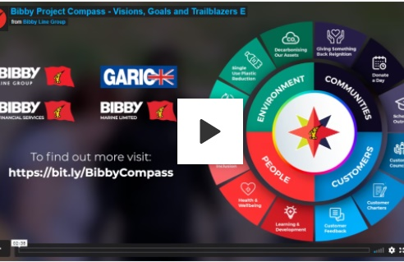
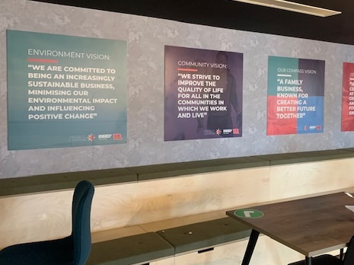
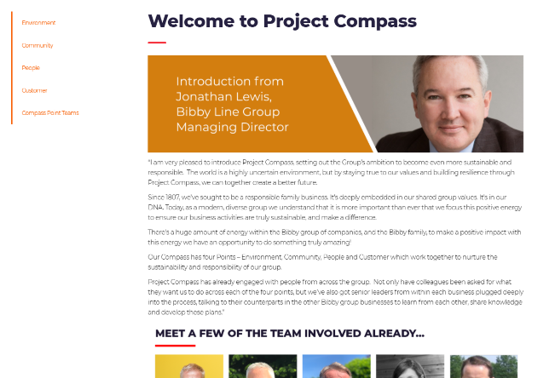
Useful Links
Document | Link
Project Compass Microsite (all latest info) | https://bibbylinegroup.co.uk/compass/
Vision, Goal and Trailblazer Video | https://bit.ly/BibbyCompassColleagueVideo
Vision, Goal and Trailblazer Press Release | https://bit.ly/3pW7ebZ
Sharing Success Template | https://bit.ly/3oUjBmF
External Corporate Framework Document | https://bit.ly/BLGCompass
Original Vision Video | https://bit.ly/3oVFS3I
Roll Banner artwork for print | https://bit.ly/3FMZayL
Wall Vision artwork for print | https://bit.ly/3DSdjdu

Slide 5
Template descriptions – January 2022
The below are examples and designed to be tweaked depending on personal style, medium and audience
Description | Template copy | When to use
Project Compass summary | Project Compass focuses our efforts on four areas to foster the long term sustainability of our Group of companies. These areas are Environment, Community, People and Customer. Working across the group, we have set ourselves ambitious sustainability goals, along with a set of 12 trailblazer projects to kickstart activity to help us meet our new group vision of being “A family business known for creating a better future together”. | When describing Project Compass as a stand alone initiative (e.g. internal newsletters, conversations, press release notes to editor)
Trailblazer or success story (News) | [project name] is part of Bibby Line Group’s new Project Compass initiative – which focuses our sustainability efforts on how we look after the environment, provide great service to customers, offer a great experience for our people and help to improve the communities in which we operate. | When describing a trailblazer or a project that supports Project Compass (e.g. any newsletter/ press release where focus is on project / trailblazer
Trailblazer or success story (Social media) | As part of Bibby Line Group’s new ‘Project Compass’ sustainability initiative, we have been [project info] #BibbyCompass | When sharing news on social media that supports Project Compass (e.g. LinkedIn / Twitter)
Sharing/ commenting on existing Compass story through social media | ‘Really proud to be working on this initiative, as part of the [XXXX] Point Team. Take a look at the link to see what we’re working on as a group’ #BibbyCompass ‘I just wanted to share this, as I’m involved as part of the [XXXX] Point Team, focusing on [XXXXX]. #BibbyCompass ‘Some really positive work going on within our business and across Bibby Line Group #BibbyCompass | When sharing or commenting on an existing social media post, to show your own involvement
About Bibby Line Group | [Subsidiary] is part of Bibby Line Group (BLG). BLG is a diverse, international business, operating around the world, employing around 1,400 colleagues, and managing over £1billion of funds. Sectors include financial services, marine and infrastructure. BLG’s purpose is to grow the long-term value of the Group. Guided by our shared group values, BLG are custodians of the family business for future generations, creating a diverse group of innovative companies that develop colleagues, delight customers and give back to communities. One of the UK’s oldest family owned business, BLG has over 210 years’ experience of providing personal, responsive and ﬂexible customer solutions. | When describing BLG e.g. in press release Notes to Editor

Slide 6
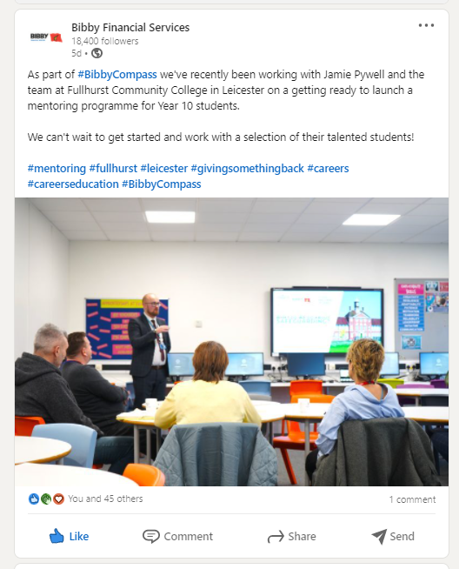
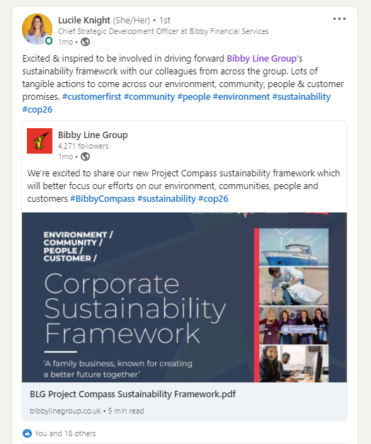
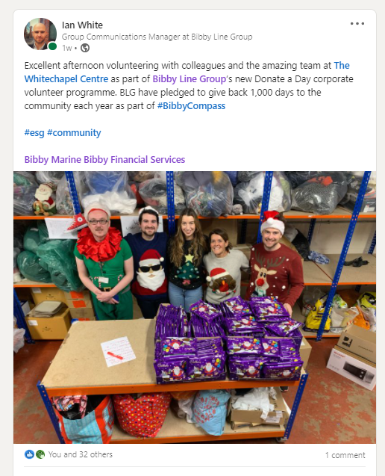
Social media examples

Slide 7
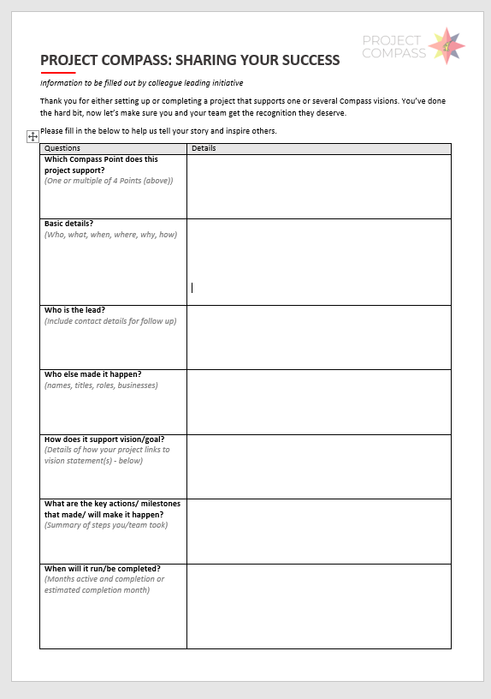
Sharing your successes
3 Point Process for celebrating success…
1. Points Teams Identify Success Story and ask Project Lead / Expert to fill in template
2. Project Lead/ Expert fills in template to share more detail and sends to Points Team and Comms
3. Comms Teams adapt info, and share through newsletters, case studies, press releases etc. to celebrate success and inspire others
We’re starting to see some brilliant success stories coming through
Let’s inspire others and make sure the people responsible get recognition
In the Useful Links section, you’ll find a template that makes it simple and fast to record any successes
It could be a Trailblazer milestone, or just a small completed project, as long as it supports one of the Compass Points, we want to hear about it!
https://bit.ly/3oUjBmF

Slide 8
Logos and graphics

Slide 9
Logo Library
1. Main logo - white
2. Main logo - black
1. & 2. These are the main logos. Please use these on posters or in documents that include projects that are working towards meeting one or several Point goals. The two versions are to allow for sufficient contrast depending on background
3. Is a simplified version and for use in graphics and presentations. It can also be used if audiences are clear on Project Compass
3. Simplified logo

Slide 10
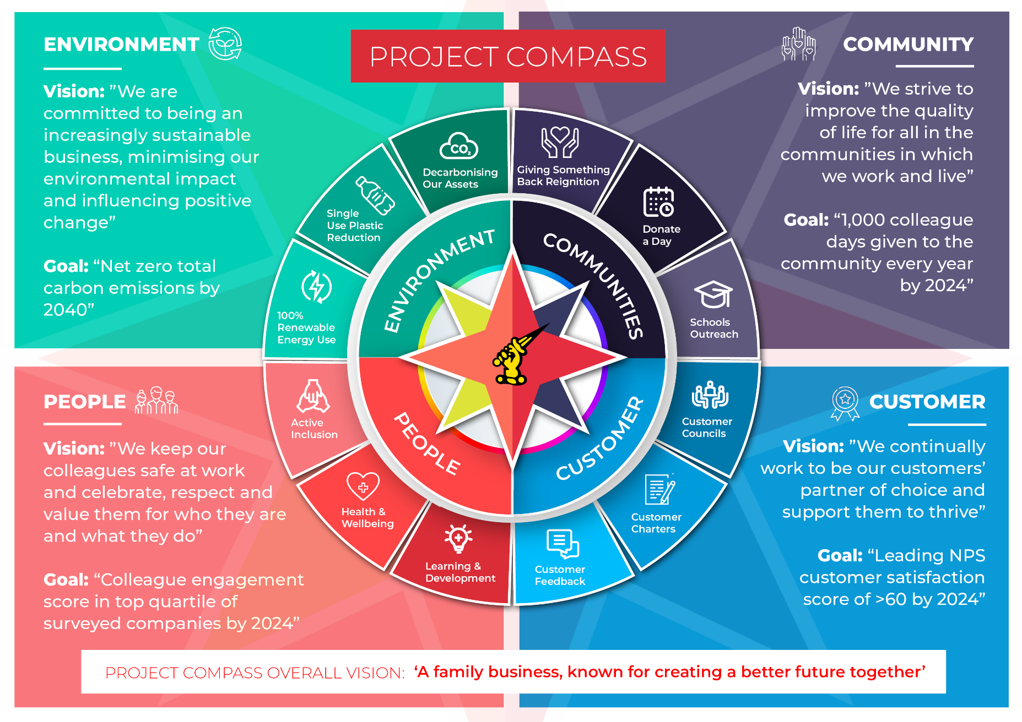
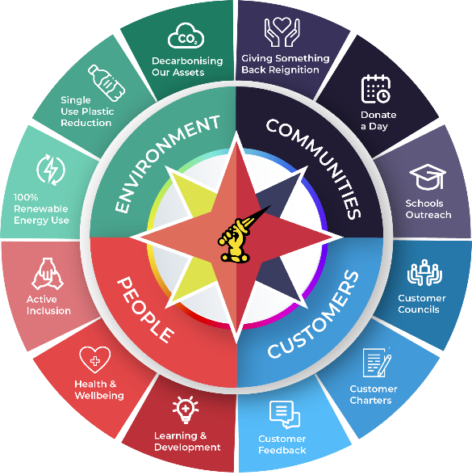
Logo Library
Full Trailblazer wheel
PEAKON FEATURES
Full Infographic
Simplified Trailblazer wheel

Slide 11
Simple Vision graphic

Slide 12
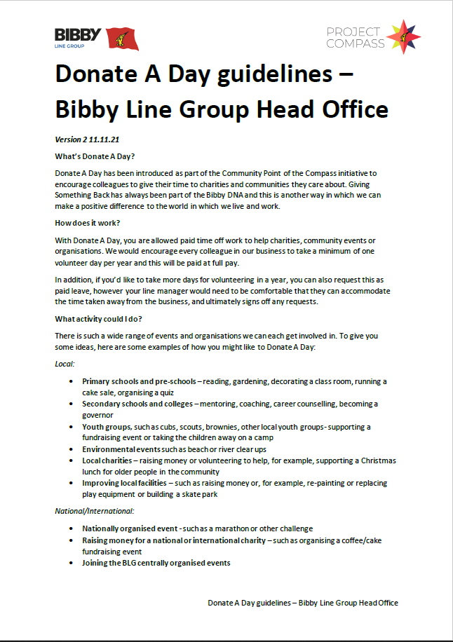
Company Logos and examples
PEAKON FEATURES
If document is for all group colleagues, use all company logos + Compass logo
If document is for one company, use the one company logo + Compass logo

Slide 13
Image Library

Slide 14
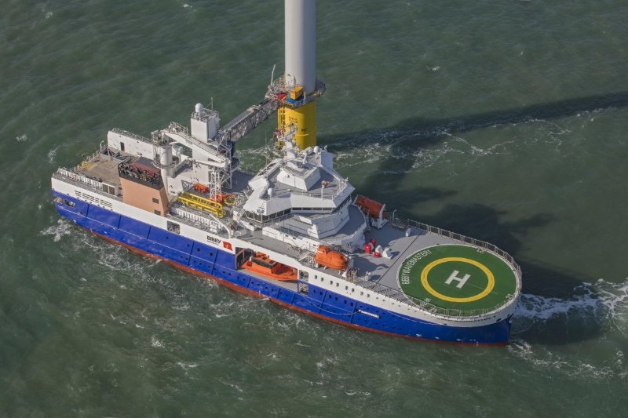
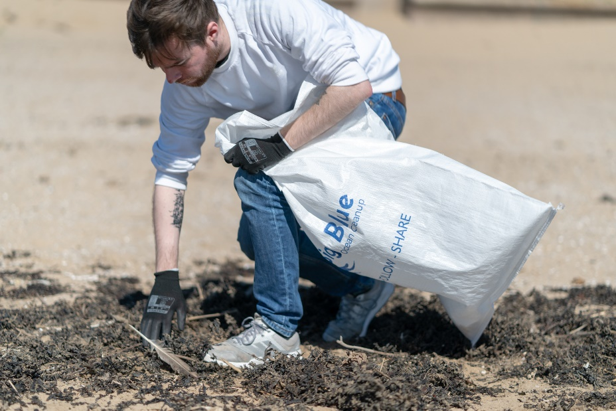
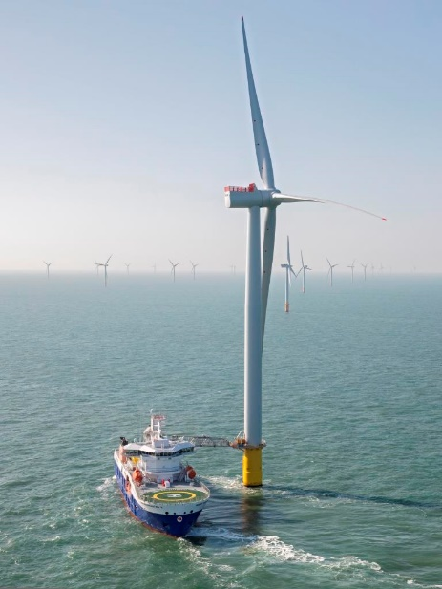
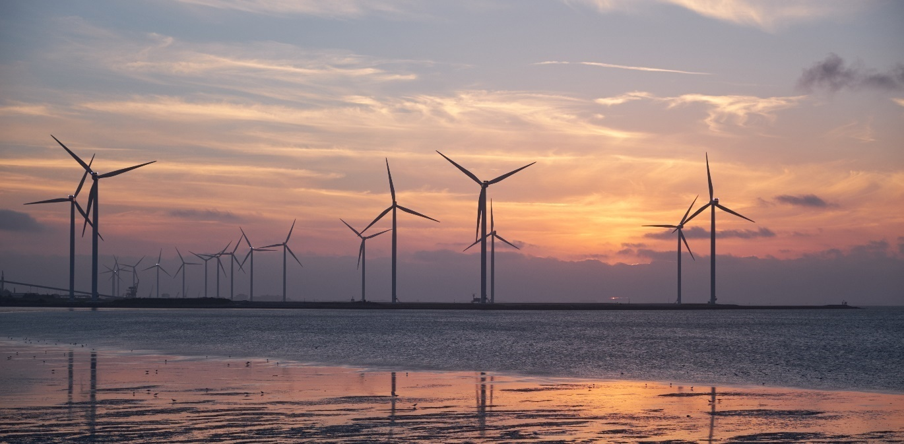
Photo Library – Environment
PEAKON FEATURES

Slide 15
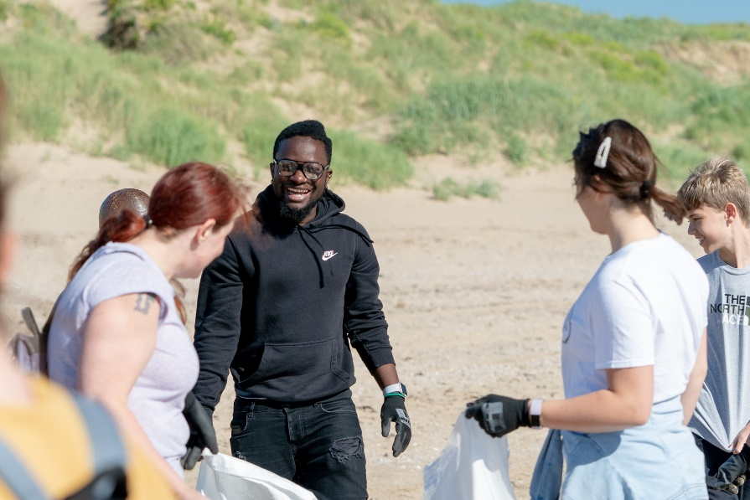
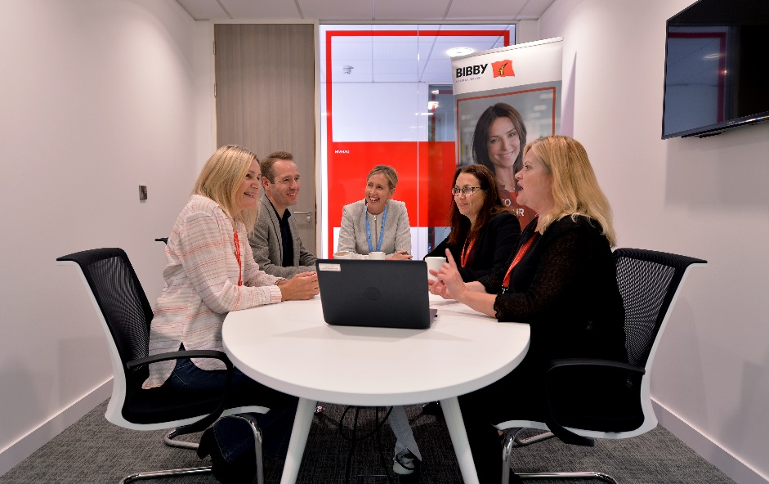
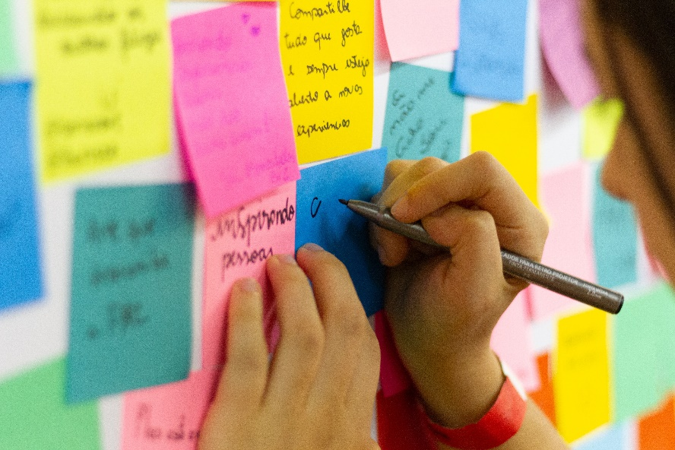
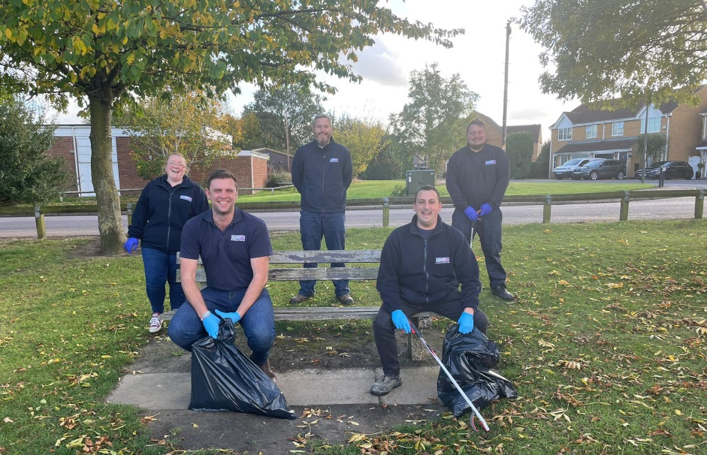
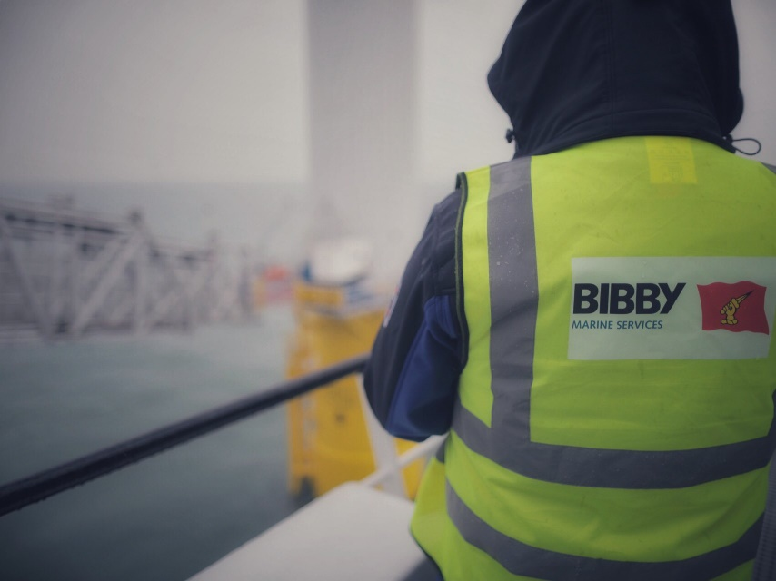
Photo Library – People

Slide 16
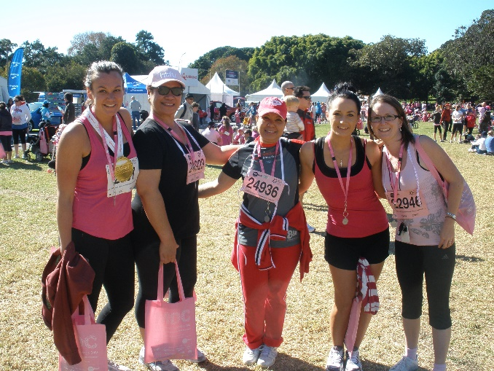
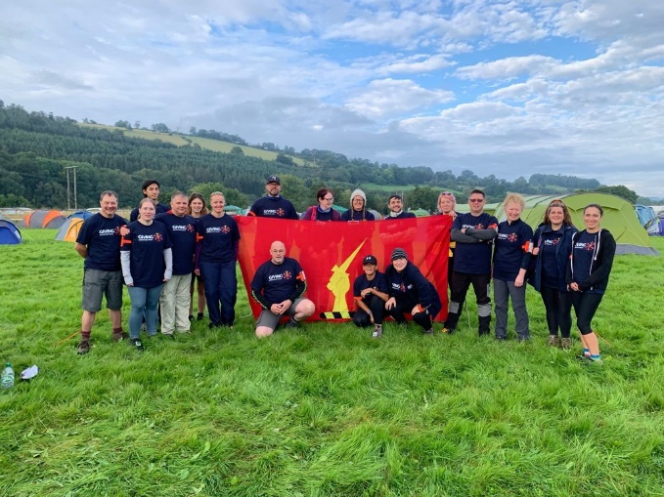
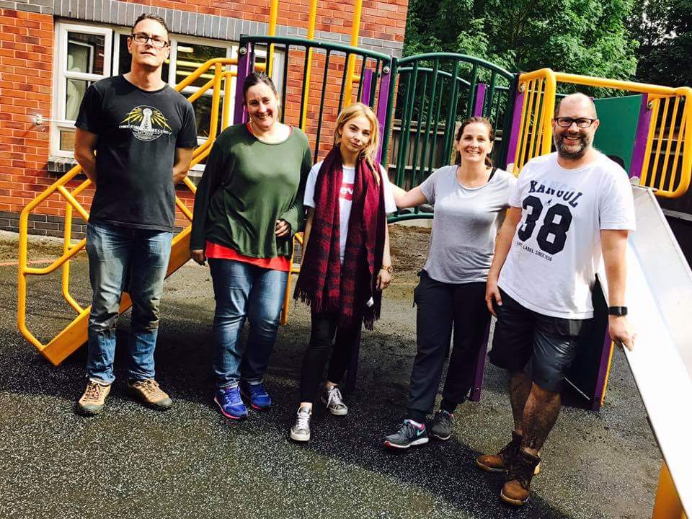
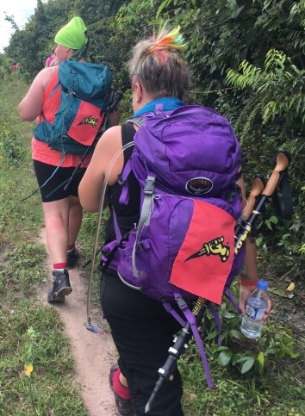
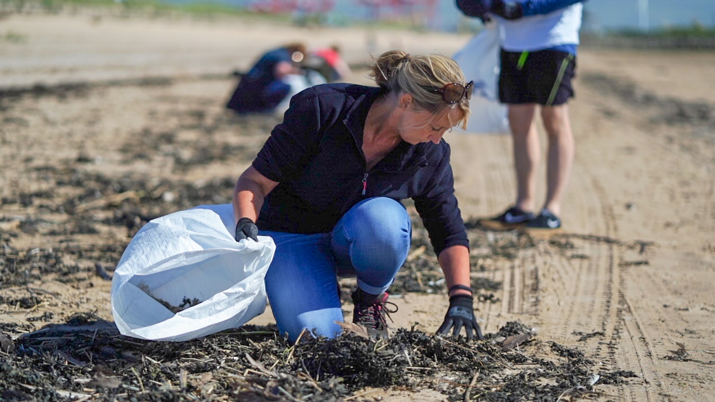
Photo Library – Community

Slide 17
Photo Library – Customer

Slide 18
Useful Contacts

Slide 19
Points Teams Contacts
PEAKON FEATURES
Environment | Community | People | Customer | Steerco
Lead: Nigel Quinn, Bibby Marine | Lead: Jonathan Andrew, Bibby Financial Services | Lead: Jacqui Barker, Bibby Line Group | Lead: Alexei Callender, Bibby Line Group | Lead: Jonathan Lewis Bibby Line Group
Joe Griffith, Garic | Jacqui Barker, Bibby Line Group | Jen Wood, Garic | Mark Tyldsley, Garic | Mark Albiston, Garic
Darren Glover, Bibby Line Group | Suzanne Cousens, Bibby Financial Services | Victoria Leadbetter, Bibby Line Group | Kevin Brown, Bibby Mairne | Nigel Quinn, Bibby Marine
Lucile Knight, Bibby Financial Services | Ian White, Bibby Line Group | Richard Garforth, Bibby Marine | Axel Sholz, Bibby Financial Services | Jonathan Andrew, Bibby Financial Services
Suzanne Cousens, Bibby Financial Services | Lucile Knight, Bibby Financial Services | Paul Roberts, Bibby Financial Services | Katy O'Mara, Garic | Jacqui Barker, Bibby Line Group
Howard Hughes, Bibby Marine | Karen McGarry, Bibby Marine | Audra Duncan, Bibby Line Group | Tracey Cotterill, Bibby Financial Services | Alexei Callender, Bibby Line Group
Francesco Sandrelli, Bibby Marine | Martin Gardener, Garic | Helen Elms, Garic | Mark Whitehead, Bibby Marine | Ian White, Bibby Line Group
Camilla Smith, Bibby NextGen |  | Suzanne Cousens, Bibby Financial Services | Tim Carroll, Garic
 |  | Michelle Boyd, Bibby Financial Services

Slide 20
Communications Plan

Slide 21
2022 Communications Plan
COMING SOON…

Slide 22
Keeping the momentum going
PEAKON FEATURES
LET’S KEEP THE MOMENTUM GOING

Slide 23
Any questions, comments, updates:
Email BLGComms@bibbylinegroup.co.uk

